Slide 1
This is a hidden slide
Dear honorable teacher please follow the instructions that has given in the slide notes (under the every slide). It would be helpful to take a successful class. Thanks a lot. I wish you good luck.

Slide 2

WELCOME

Slide 3


IDENTITY
SK. Md. Harunar Rashid
Senior Assist: Teacher
Sonatola Model High School, Sonatola, Bogra.
Lesson
ENGLISH FOR TODAY
CLASS : SIX
UNIT – 26
Notes:
Teacher can hide this slide.

Slide 4
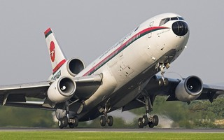
Let`s enjoy a video clip
Click here
Notes:
After showing this video teacher can ask who go to aboard and why.

Slide 5
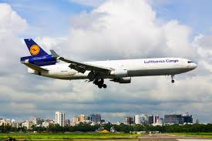
Sir, I mean varieties classes men are the passengers of this Biman. Such as Govt: officers, business man, students, Patients, tourists and our wage earners.
Can you imagine who are the passenger of this Biman.
Notes:
This slide only for learners mind set up for classroom arrange.

Slide 6
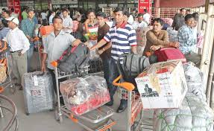
LESSON DECLARATION
OUR WAGE EARNERS

Slide 7
Learning outcomes
After completing the lesson students will be able to -
read and understand texts
infer meaning from context
ask and answer questions
Participate in short dialogues and conversations on familiar topics

Slide 8
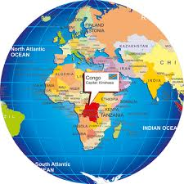
Our wage earners work in many countries in the world they are mainly United Arab Emirates (UAE), Oman, Qatar, Bahrain, Kuwait, Iran, Iraq Jordan, Syria, Egypt, Libya, Malaysia United Sates of America (USA), Canada, Australia, Singapore, New Zealand, United Kingdom and many other European countries.
Notes:
Slide number 7 – 15 teacher only show the countries and can discuss shortly about the selected countries.

Slide 9
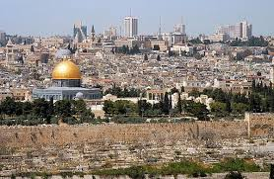
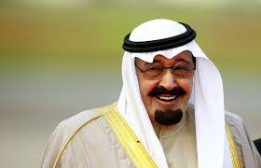
Saudi Arab - UAE
Notes:
Slide number 7 – 15 teacher only show the countries and can discuss shortly about the selected countries.

Slide 10
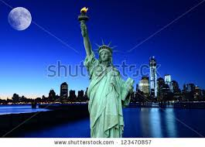
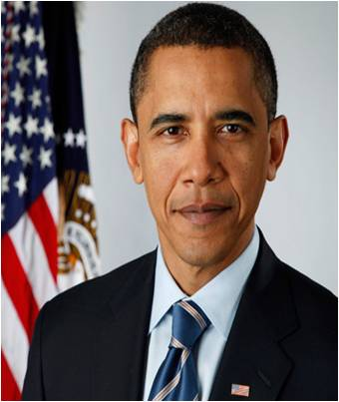
America - USA
Notes:
Slide number 7 – 15 teacher only show the countries and can discuss shortly about the selected countries.

Slide 11
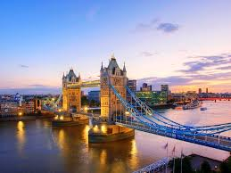

England - UK
Notes:
Slide number 7 – 15 teacher only show the countries and can discuss shortly about the selected countries.

Slide 12
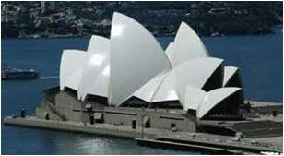

Australia
Notes:
Slide number 7 – 15 teacher only show the countries and can discuss shortly about the selected countries.

Slide 13


Kuwait
Notes:
Slide number 7 – 15 teacher only show the countries and can discuss shortly about the selected countries.

Slide 14
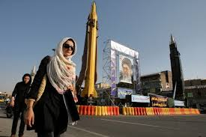

Iran
Notes:
Slide number 7 – 15 teacher only show the countries and can discuss shortly about the selected countries.

Slide 15
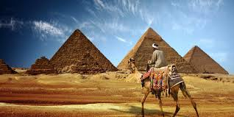

Egypt
Notes:
Slide number 7 – 15 teacher only show the countries and can discuss shortly about the selected countries.

Slide 16

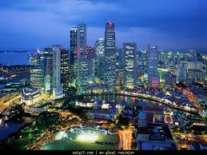

Singapore
Notes:
Slide number 7 – 15 teacher only show the countries and can discuss shortly about the selected countries.

Slide 17
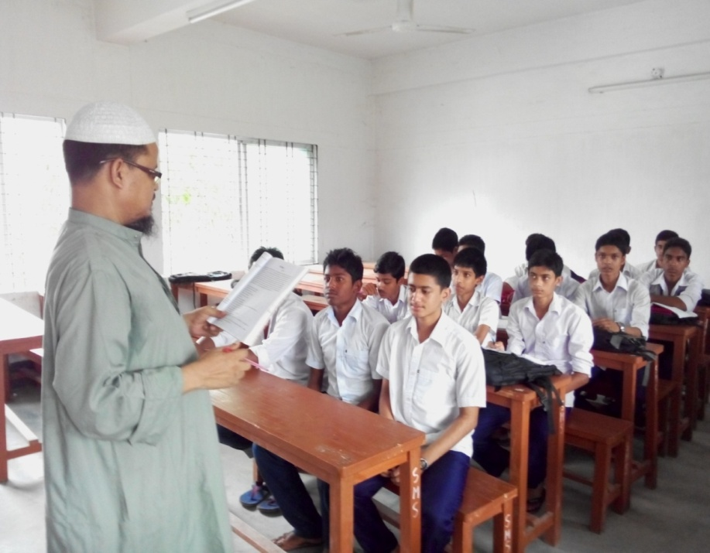
Model reading
Dear students, listen the text attentively then go to Section B1 and complete column B of the following table with the information from the text .
Notes:
Students will go to the section BI and complete the table, teacher will monitor the class.

Slide 18

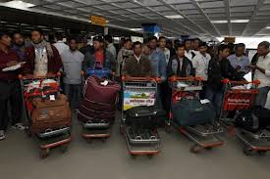
Wage earner
Key word
They are wage earners coming form abroad.
Meaning
(Click here)
Who earn money.
Notes:
First, the word can be shown. The SS can be asked to pronounce the word. If it is needed teacher can help. Then the picture can be shown and asked to guess the meaning. For feedback click on meaning button.

Slide 19
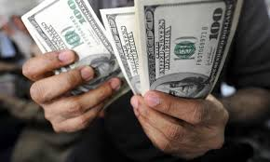
Remittance
Key word
Our wage earners send remittance to their family that increase our economical condition.
Meaning
(Click here)
allowance
Notes:
First, the word can be shown. The SS can be asked to pronounce the word. If it is needed teacher can help. Then the picture can be shown and asked to guess the meaning. For feedback click on meaning button.

Slide 20
Immigration
Key word
They are migrated to the USA, the UAE and other countries .
Meaning
(Click here)
Migration (go to another country).
Notes:
First, the word can be shown. The SS can be asked to pronounce the word. If it is needed teacher can help. Then the picture can be shown and asked to guess the meaning. For feedback click on meaning button.

Slide 21
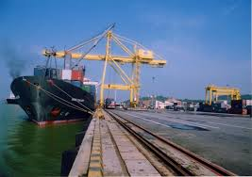
Export
Key word
Bangladesh has started export rice to Srilanka.
Meaning
(Click here)
Send to other countries
Notes:
First, the word can be shown. The SS can be asked to pronounce the word. If it is needed teacher can help. Then the picture can be shown and asked to guess the meaning. For feedback click on meaning button.

Slide 22
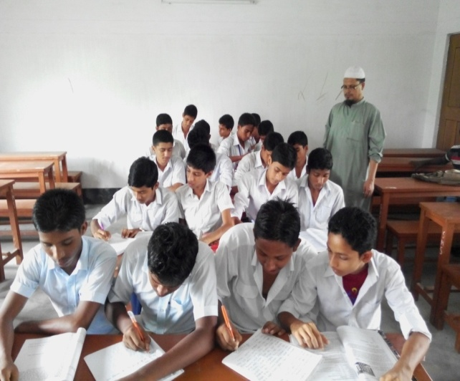
Silent reading.
Go to the text, Section ‘B’ . Work in pairs,. Ask and answer the following question first. Then read the text to match your answers.
# Do you know how many Bangladeshis work abroad ?
# Do you know what countries they work in ?
# Can you guess how hard they work ?
Notes:
After reading students will try to write the answer o their note books or on blackboard.

Slide 23
Pair Works
Make five meaningful sentences from the table.
A large number of | Is created | abroad only in May.
Nearly 73 thousands jobseekers | Wage earners abroad was | abroad for job
Remittance from Bangladesh | Skilled | In Malaysia too.
In May 2012 a large number of | Bangladeshi | US D 11.76 billion in May 2012.
The scope of manpower | Went | professionals also migrate to the USA.
Notes:
Students can give some time to read the text.

Slide 24

HOME WORK
Make a dialogue between you and your partner about the importance of professionals skills for our wage earners.

Slide 25
Acknowledgement
We would like to express our cordial gratitude to the Ministry of Education, Directorate of Secondary & Higher Education, NCTB, a2i
and
the panel of honorable editors ( Md. Jahangir Hasan, Associate Professor (English) TTC, Rangpur, Ranjit Poddar, Associate Professor (English) TTC, Dhaka, and Urmila Ahmed, Associate Professor (English) TTC, Dhaka, to enrich the contents.

Slide 26
THE END

